Slide 1
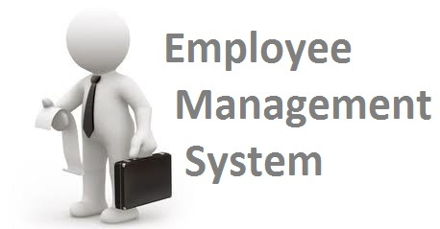
EMPLOYEE RECORD MANAGEMENT SYSTEM(ERMS)

Slide 2

ABC UNIVERSITY
Guided By: Presented By:
Prof. AAAAAAAAAAA BBBBBBBBB
CCCCCCCCC

Slide 3

DEVELOPERS
BBBBBBBBB
cccccccccccccc

Slide 4
Introduction
Employee Record Management system is a database which keeps the record of all the details pertaining to employees in an organization.
Organizations have always had to collect and use personal information from and about employees to comply with tax and other laws, to administer benefits, to operate their businesses.

Slide 5
Project Scope
The scope of the project is to store and access the database consisting of employee’s personal details and the database can be shared with the concerned department to complete joining formalities
We can also store and access the database consisting of program details.
The project has a wide scope, as it is not intended to a particular organization. This project is going to develop generic software, which can be applied by any businesses organization. More over it provides facility to its users. Also the software is going to provide a huge amount of summary data.

Slide 6
Proposed System
The development of the new system contains the following activities, which try to automate the entire process keeping in view of the database integration approach.
User friendliness is provided in the application with various controls.
The system makes the overall project management much easier and flexible.
There is no risk of data mismanagement at any level while the project development is under process.
It provides high level of security with different level of authentication.

Slide 7
Modules
Employee Record Management System project divided in two modules :
User Module
Admin Module

Slide 8
User Modules:
User can register himself.
User login
User password recovery.
User can add / edit own work experience details
User can add / edit own education details.
User can edit own profile.
User can update own password.
Logout

Slide 9
Admin Modules:
Admin Login
Admin can manage all employee records.
Admin can update / edit user personal details/ work exp. details / Education.
Admin can update own profile
Change password
Logout

Slide 10
SOFTWARE USED
PYTHON INTERPRETER
PYCHARM IDE (INTEGRATED DEVELOPMENT ENVIRONMENT)
DJANGO FRAMEWORK
NOTEPAD++ OR ANY OTHER TEXT EDITOR
CHROME OR ANY OTHER BROWSER

Slide 11
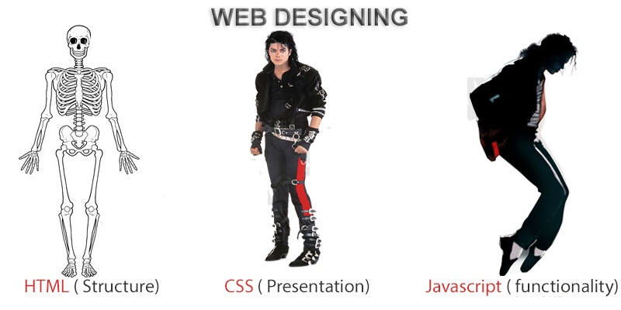
FRONTEND (LANGUAGE USED)
HTML (HYPERTEXT MARKUP LANGUAGE)
CSS (CASCADING STYLE SHEET)
BOOTSTRAP (FRAMEWORK OF CSS AND JS)

Slide 12

BACKEND
PYTHON DJANGO
SQLITE (DATABASE)

Slide 13
SYSTEM DESIGN
Unified Modeling Language:
UML stands for Unified Modeling Language. It is a third generation method for specifying, visualizing and documenting the artifacts of an object oriented system under development. Object modeling is the process by which the logical objects in the real world (problem space) are represented (mapped) by the actual objects in the program (logical or a mini world). This visual representation of the objects, their relationships and their structures is for the ease of understanding. This is a step while developing any product after analysis.

Slide 14
The Unified Modeling Language encompasses a number of models.
Use case diagrams
Class diagrams
Sequence diagrams

Slide 15
Use Case Diagram:
Use case diagram consists of use cases and actors and shows the interaction between them. The key points are:
The main purpose is to show the interaction between the use cases and the actor.
To represent the system requirement from user’s perspective.
The use cases are the functions that are to be performed in the module.
An actor could be the end-user of the system or an external system.

Slide 16
Use Case Diagrams – Admin :
Dashboard
Manage Employee Details(Edit)
Manage Employee Education (Edit)
Manage Employee Experience (Edit)
Change Password
Update Own Profile

Slide 17
Use Case Diagrams User:
Signup
Signin
Dashboard
Manage Education(Add/ Edit)
Manage experience(Add/ Edit)
Update Own Profile
Change Password

Slide 18
Sequence Diagram:
The purpose of sequence diagram is to show the flow of functionality through a use case. In other words, we call it a mapping process in terms of data transfers from the actor through the corresponding objects.

Slide 19
SEQUENCE DIAGRAM

Slide 20
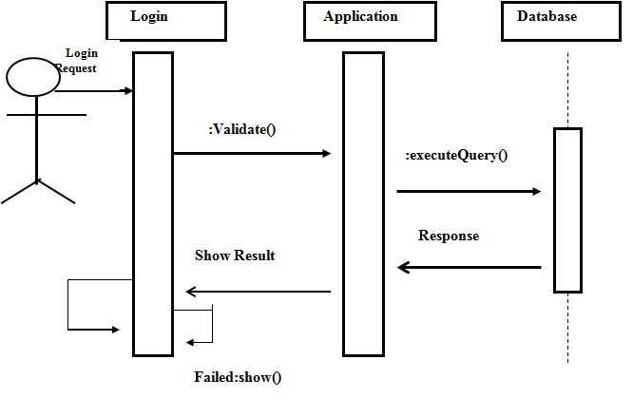
Sequence Diagram For Administrator:-

Slide 21
Data Flow Diagram(DFD) First Level
0.0
Employee Record
Management system
Employeee
Administrator

Slide 22
Data Flow Diagram(DFD) 2nd Level
1.1
Records
Administrator
Administrator
1.2
Employee

Slide 23
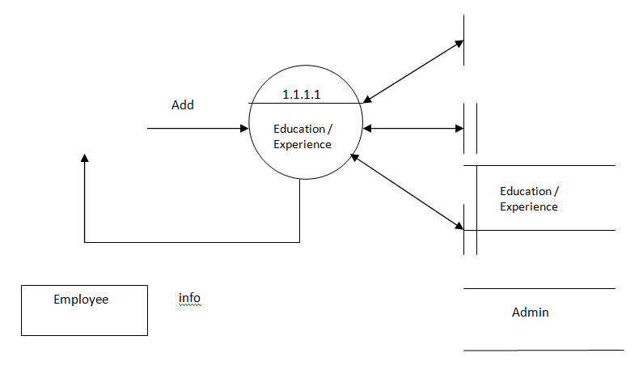
Data Flow Diagram(DFD) 3rd Level

Slide 24
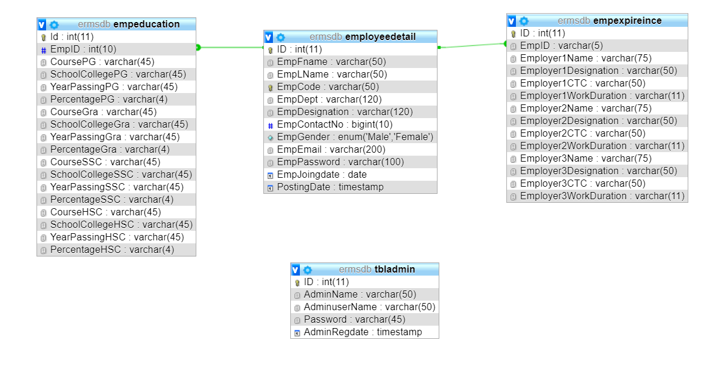
Class Diagram

Slide 25
ER Diagram

Slide 26
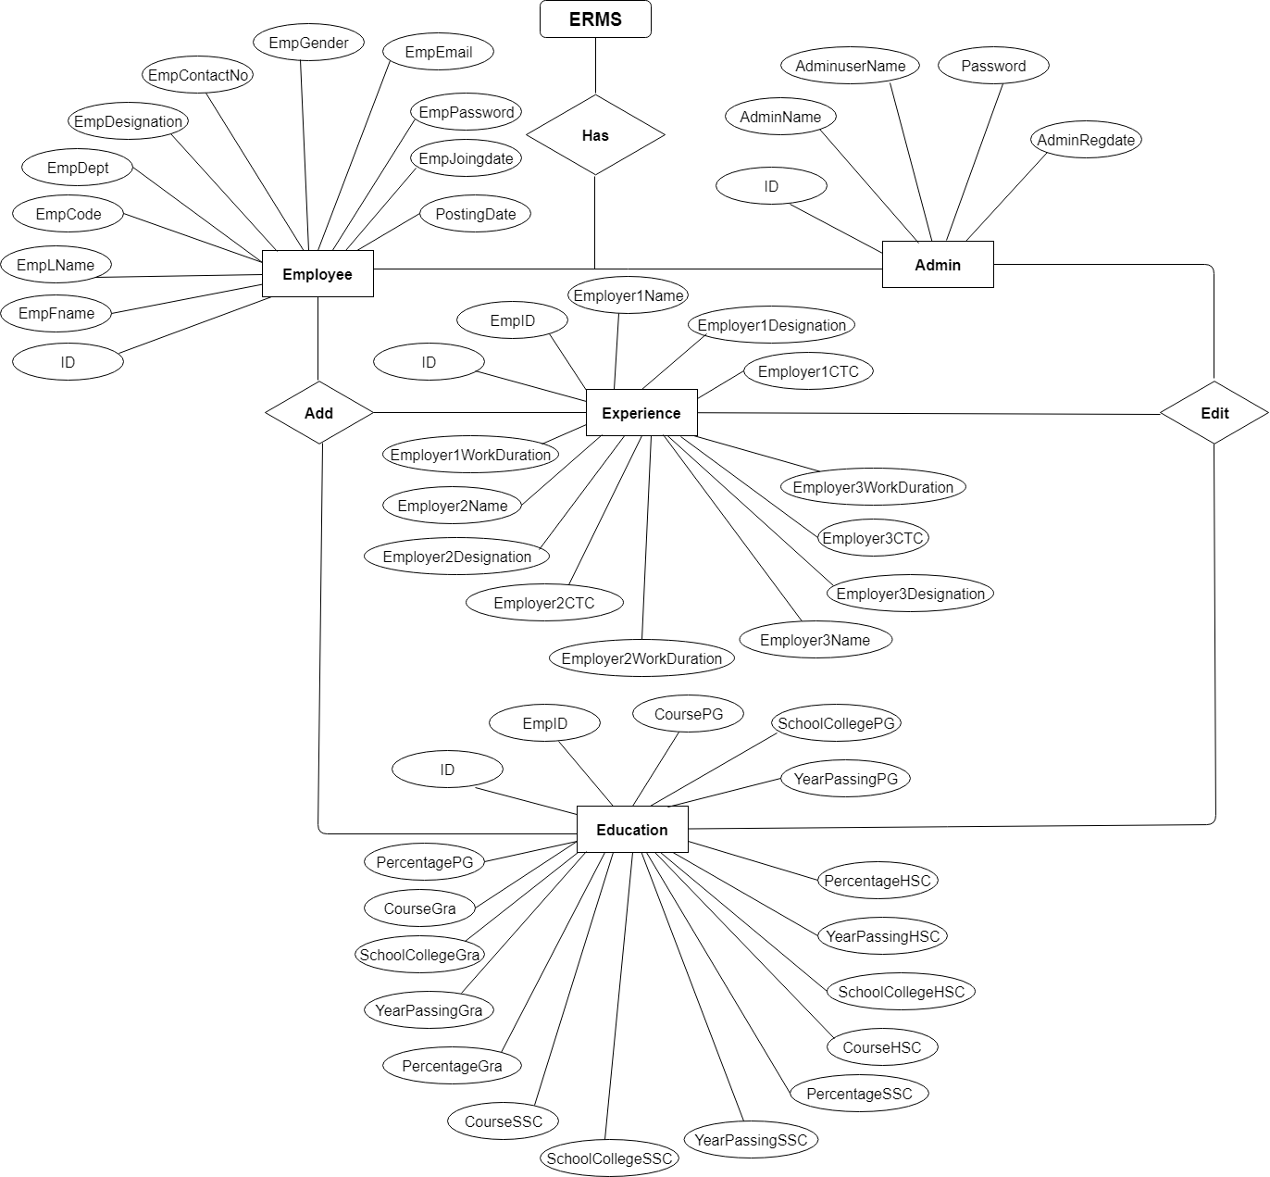

Slide 27
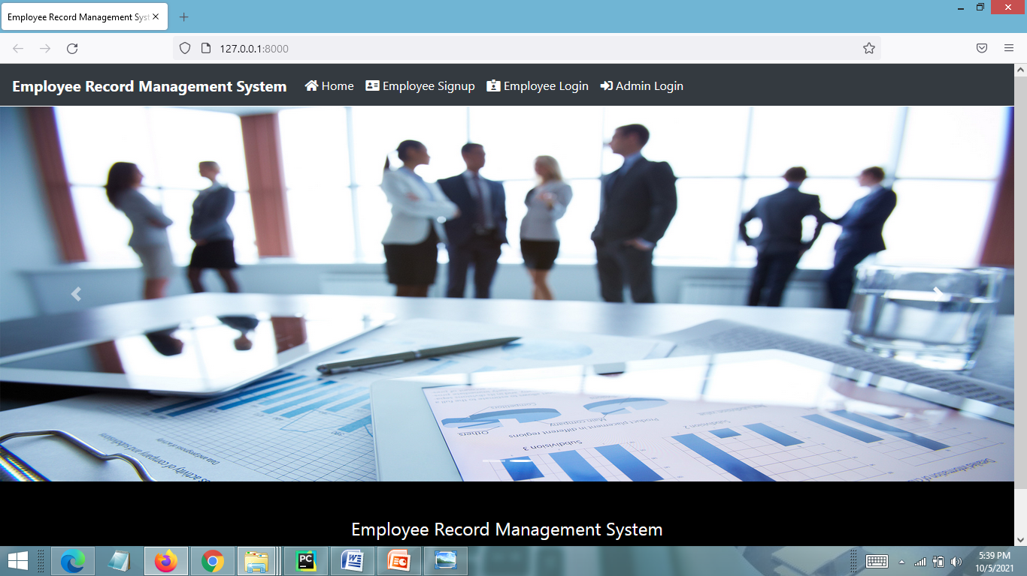
SCREEN SHOTS – Home Page

Slide 28
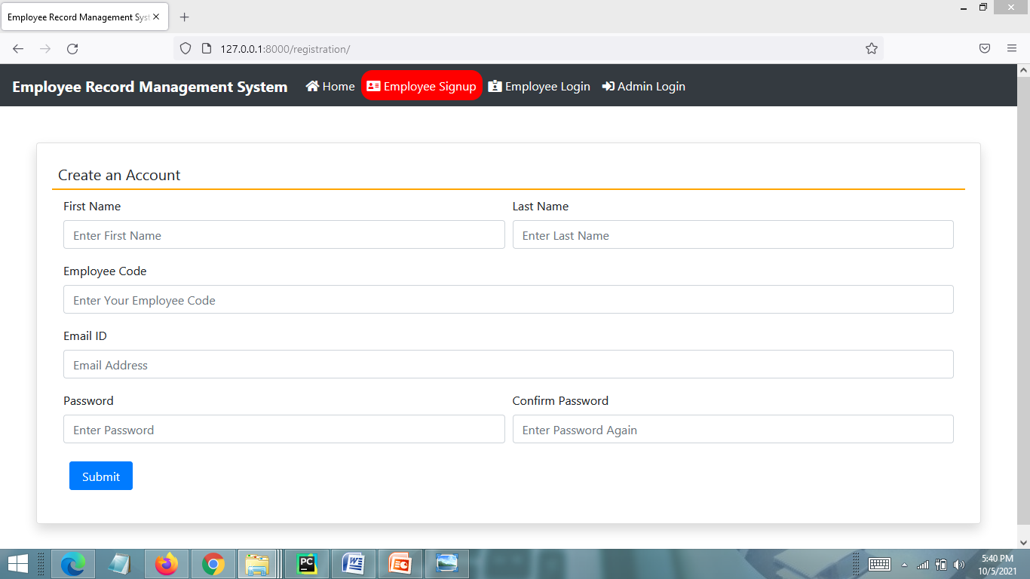
Employee Signup Page

Slide 29
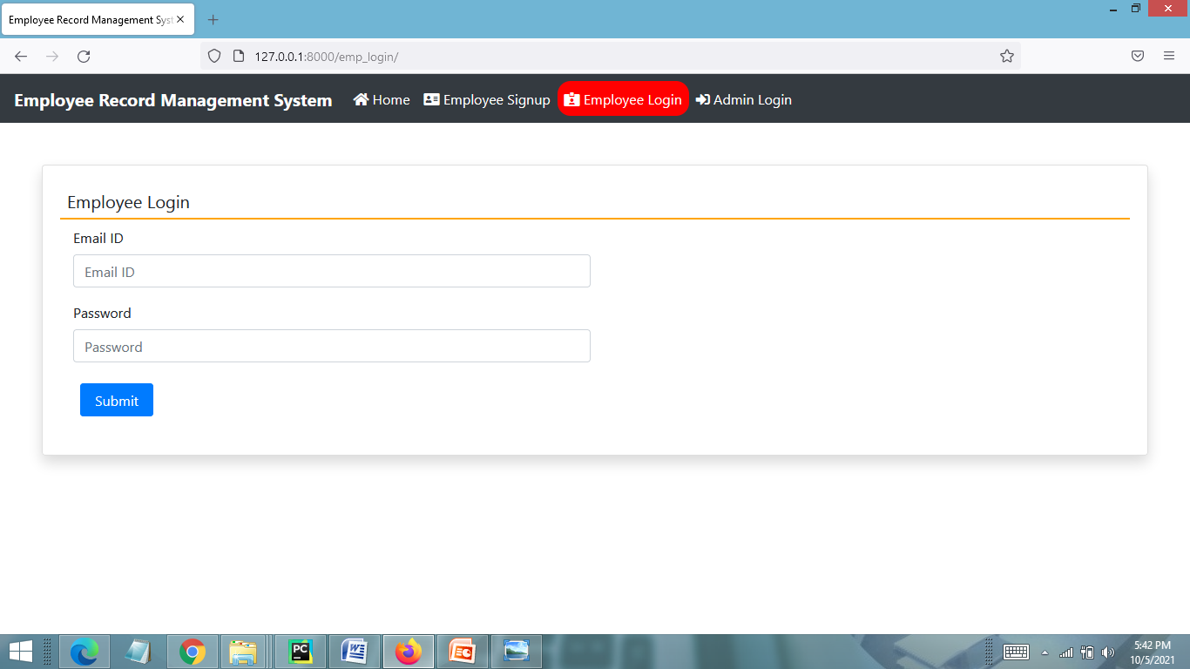
EMPLOYEE LOGIN PAGE

Slide 30
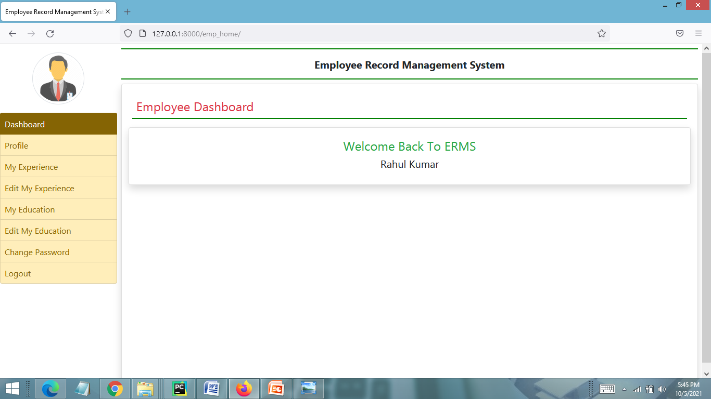
EMPLOYEE DASHBOARD PAGE

Slide 31
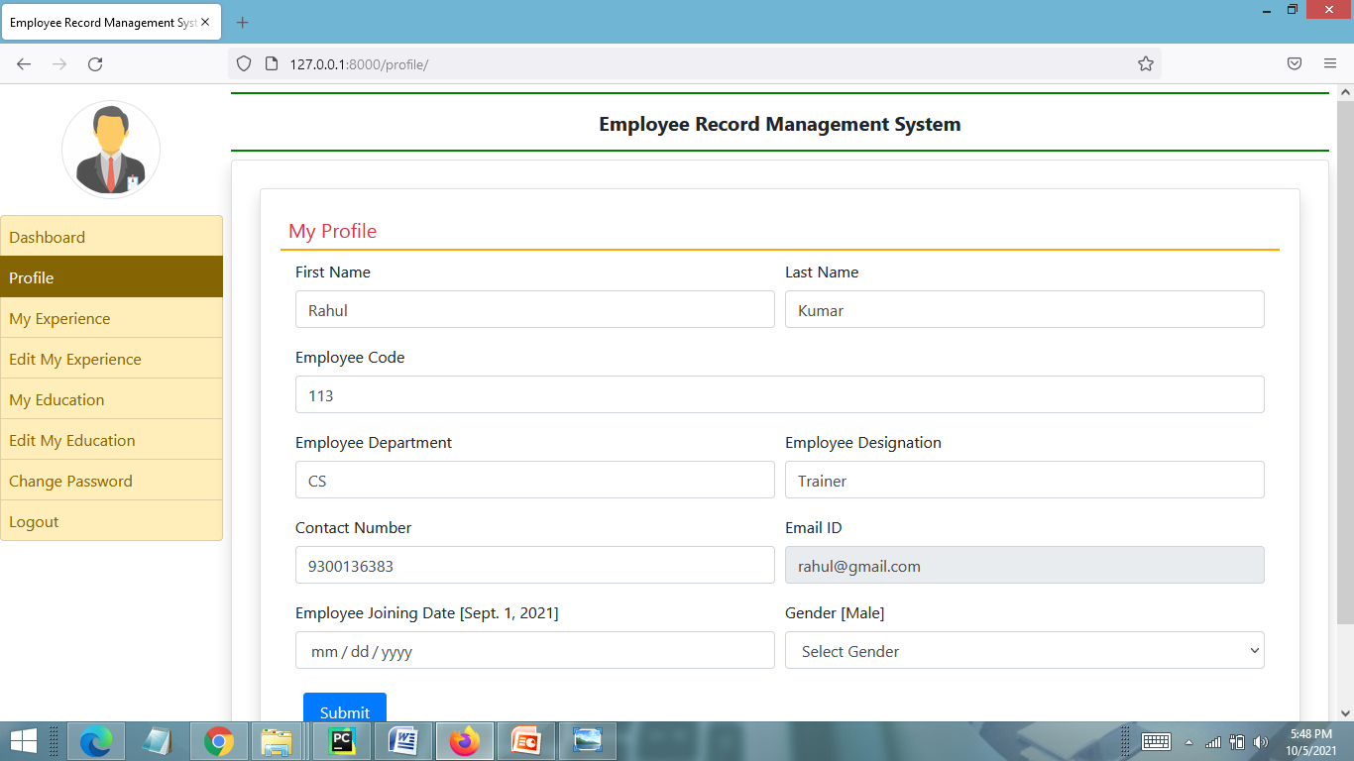
MY PROFILE PAGE

Slide 32
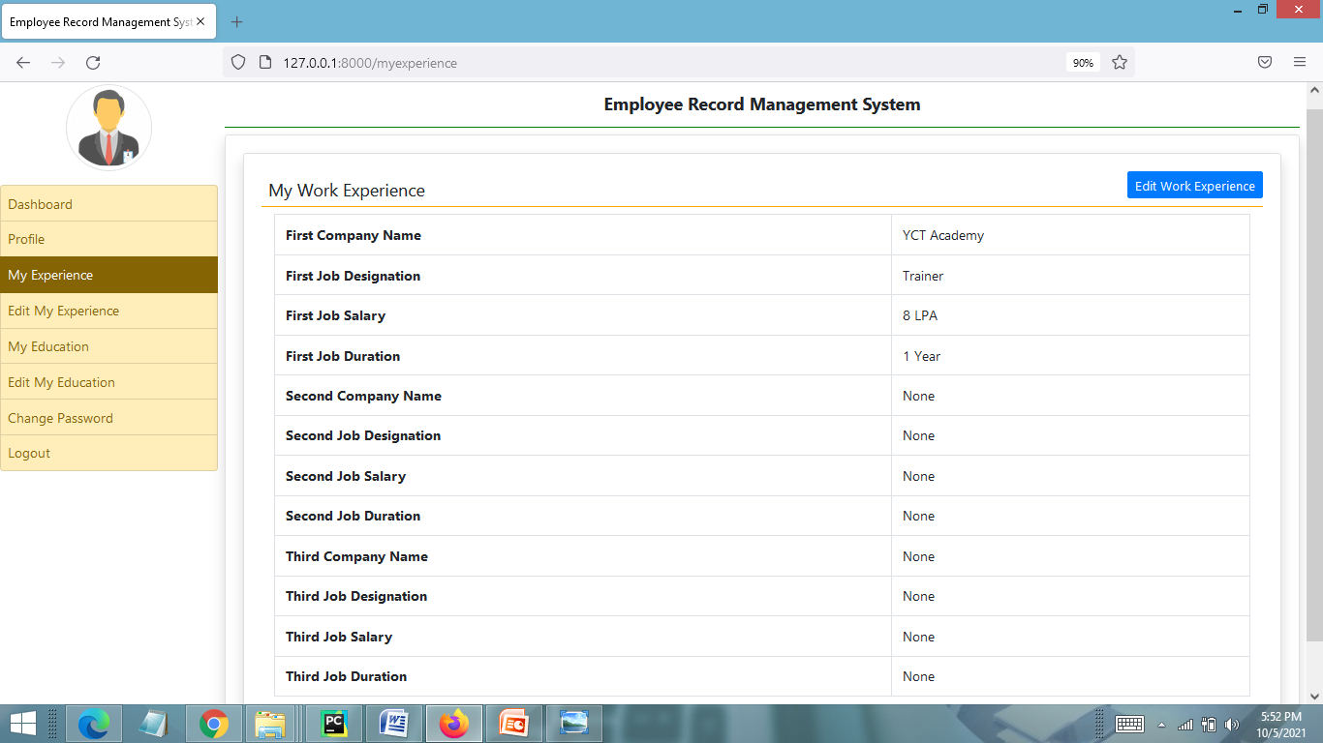
VIEW MY WORK EXPERIENCE PAGE

Slide 33
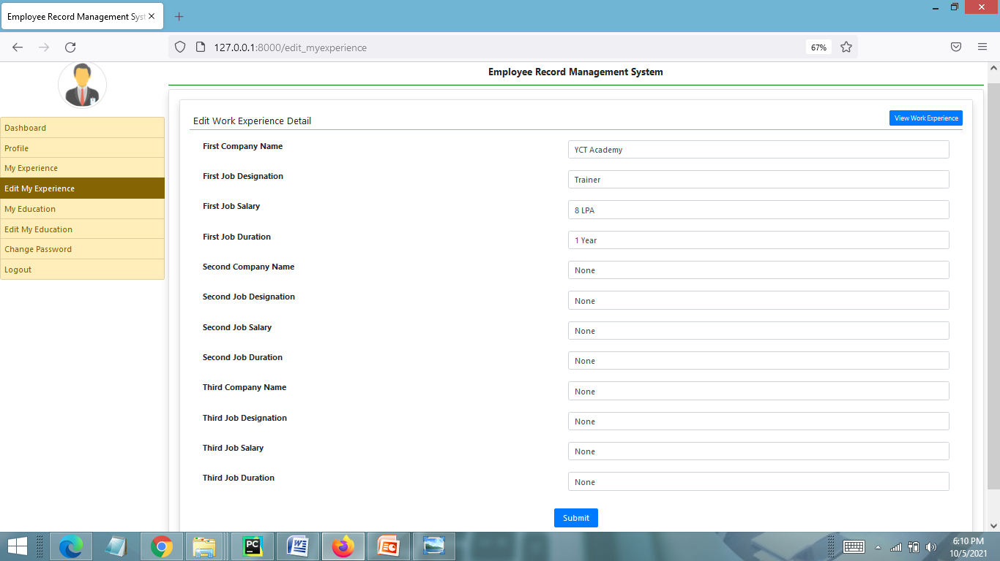
EDIT MY WORK EXPERIENCE PAGE

Slide 34
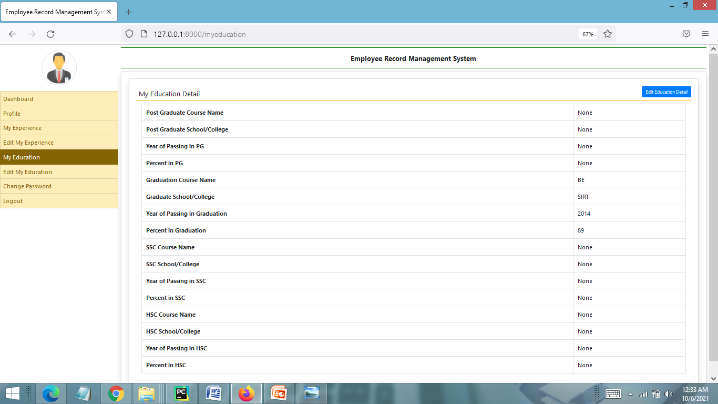
View My Education Detail Page

Slide 35
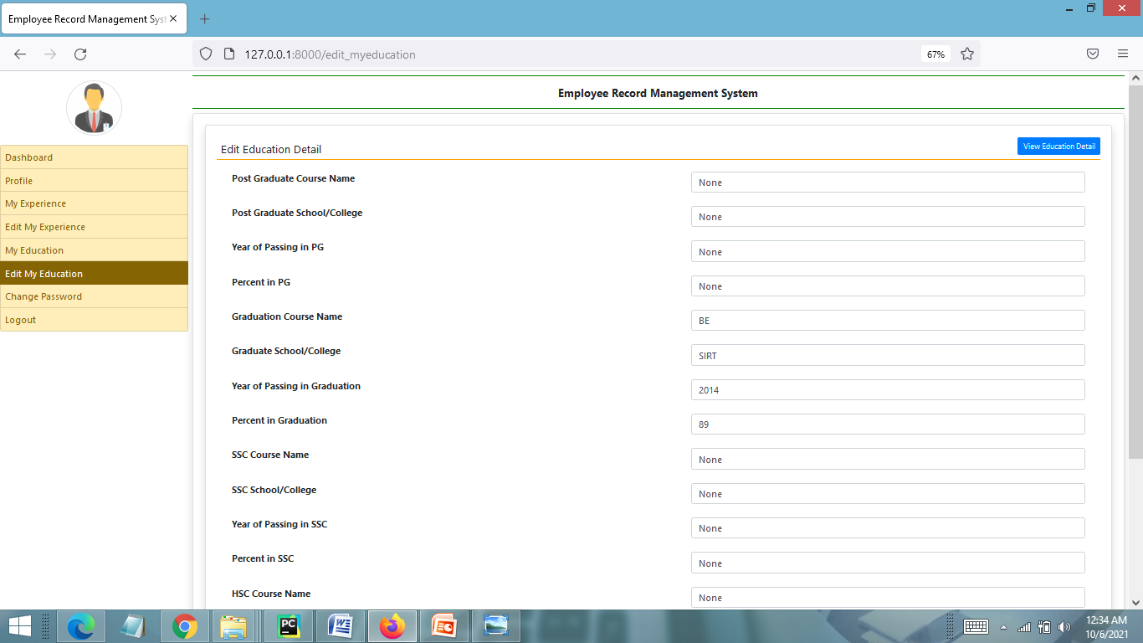
Edit Education Detail Page

Slide 36
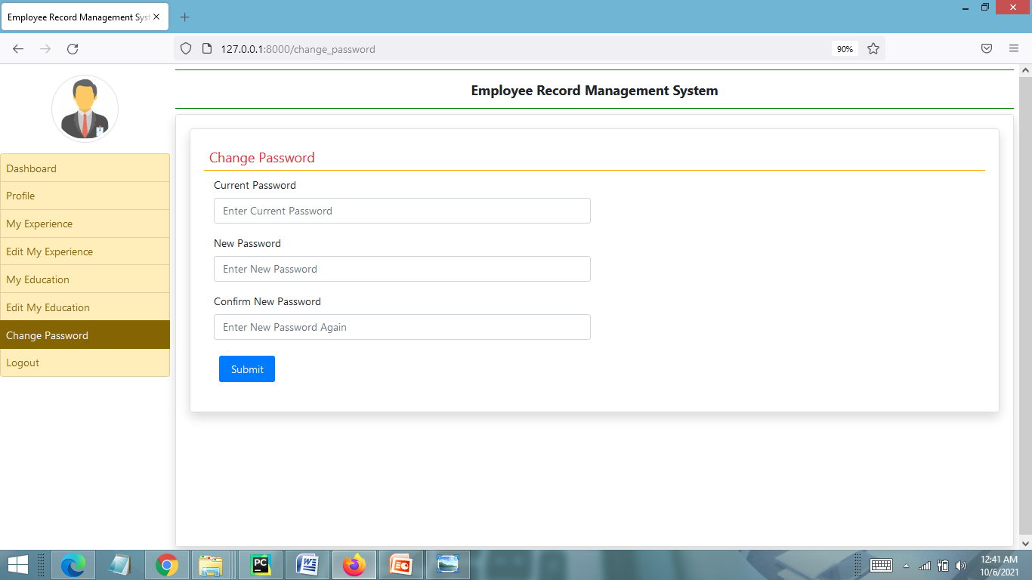
CHANGE PASSWORD PAGE

Slide 37
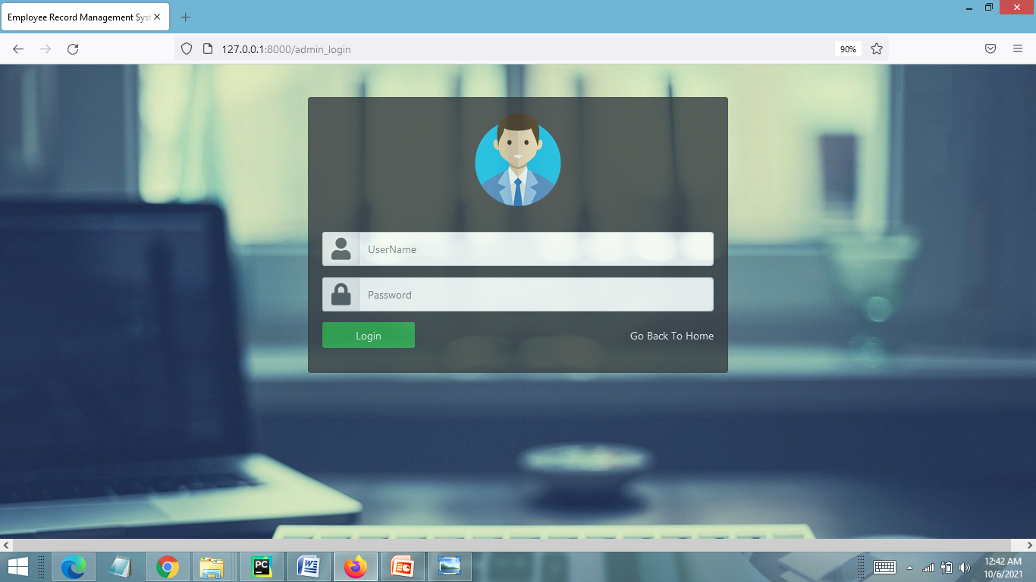
ADMIN LOGIN PAGE

Slide 38
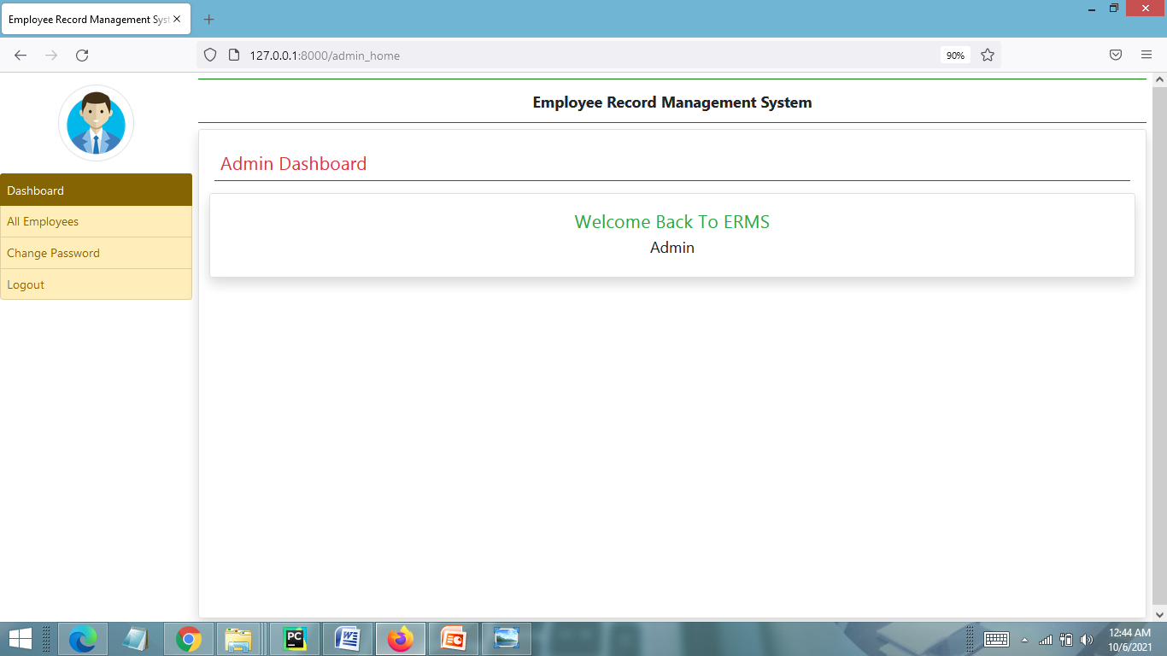
ADMIN HOME PAGE

Slide 39
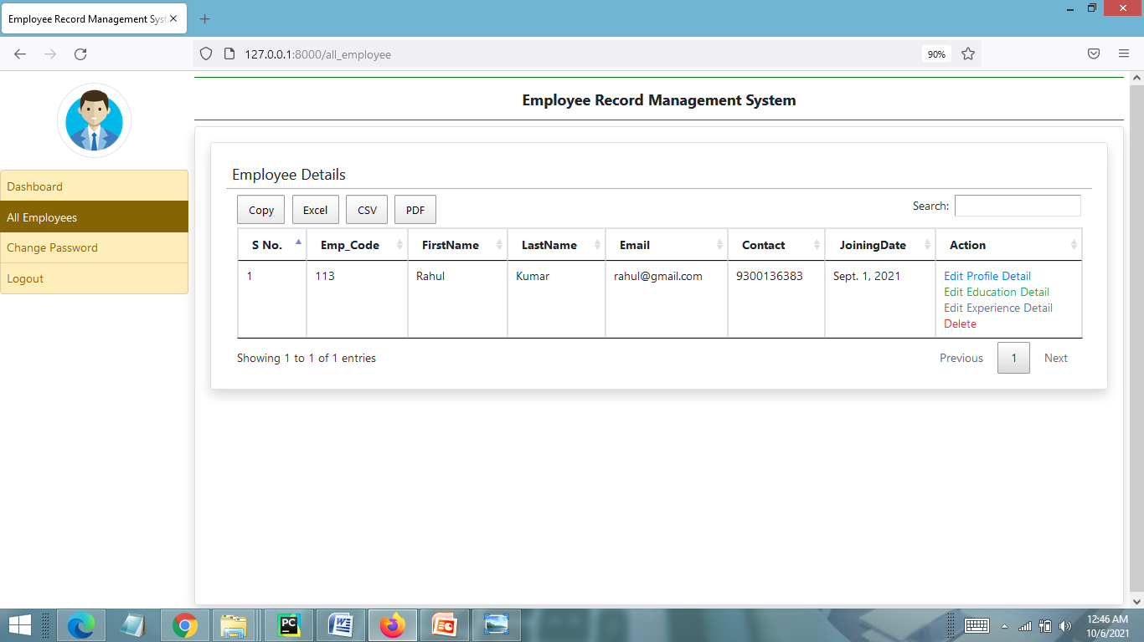
MANAGE EMPLOYEE DETAIL PAGE

Slide 40
FUTURE SCOPE
This web application involves almost all the basic features of the online employee management system. The future implementation will be online help for the employees and chatting with website administrator.

Slide 41
CONCLUSION
The project titled as Employee Record Management System was deeply studied and analyzed to design the code and implement. It was done under the guidance of the experienced project guide. All the current requirements and possibilities have been taken care during the project time.
Employee record management system is used for daily operations in any organization to maintain or access employee related information for internal administration purposes.

Slide 42
BIBLIOGRAPHY
FOR PYTHON INSTALLATION
https://www.python.org
FOR HTML , CSS ANF PYTHON BASICS
www.w3schools.com
www.javatpoint.com
https://www.geeksforgeeks.org/python-django/
REFERENCE BOOKS
Two scoops of Django for 1.11 by Daniel Greenfeld’s and Audrey Greenfield
Lightweight Django by Elman and Mark Lavin

Slide 43
THANKYOU

